Slide 1
Traffic Shaping

Slide 2
Traffic Shaping
Traffic shaping is a bandwidth management technique used on computer networks which delays some or all datagrams.
If a link becomes saturated to the point where there is a significant level of contention latency can rise substantially causing users face a slow access to the newtork resources.
Traffic shaping can be used to prevent this from occurring and keep latency in check.
Traffic shaping provides a means to control the volume of traffic being sent into a network in a specified period or the maximum rate at which the traffic is sent.
Traffic shaping is used to optimize or guarantee performance, improve latency, or increase usable bandwidth for important traffic by delaying other not so important traffic.

Slide 3
Traffic Shaping
The most common type of traffic shaping is application-based traffic shaping.
Simple traffic shaping schemes shape all traffic uniformly by rate.
More sophisticated shapers first classify traffic.
Traffic classification categorises traffic (for example, based on port number or protocol).
Different classes can then be shaped separately to achieve a desired effect.
Bandwidth throttling is the intentional slowing or speeding of an Internet service by a network administrator.
It is a reactive measure employed in communication networks to regulate network traffic and minimize bandwidth congestion.
Bandwidth throttling can occur at different locations on the network.

Slide 4
Traffic Shaping
Throttling can be used to actively limit a user's upload and download rates on programs such as video streaming, BitTorrent protocols and other file sharing applications.
In computer networks, rate limiting is used to control the rate of traffic sent or received by a network interface controller.
Rate limiting is another technique used for traffic shaping.
Datacenters widely use rate-limiting to control the share of resources given to different tenants and applications according to their service level agreement.
A variety of rate-limiting techniques are applied in datacenters using software and hardware.
Two important performance metrics of rate-limiters in datacenters are resource footprint (memory and CPU usage) which determines scalability, and precision.

Slide 5
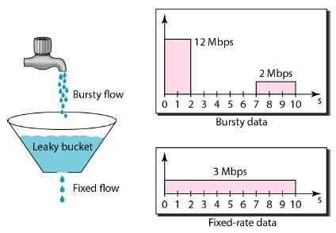
Traffic Shaping
Leaky Bucket :
When the host has to send a packet , packet is thrown in bucket.
Bucket leaks at constant rate.
Bursty traffic is converted into uniform traffic by leaky bucket.
In practice bucket is a finite queue outputs at finite rate.

Slide 6
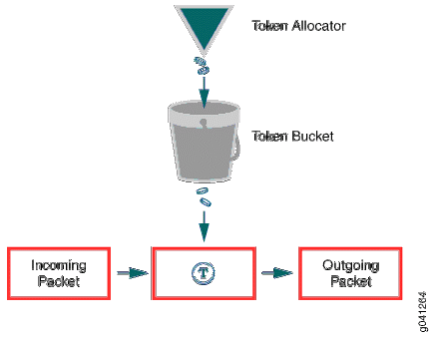
Traffic Shaping
Token Bucket :
In this leaky bucket holds tokens generated at regular intervals of time.
Bucket has maximum capacity.
If there is a ready packet , a token is removed from Bucket and packet is send.
If there is a no token in bucket, packet can not be send.

Slide 7
Traffic Shaping
Main advantage of token Bucket over leaky bucket -
1.If bucket is full in token Bucket , token are discard not packets.
While in leaky bucket , packets are discarded.
2. token Bucket can send Large bursts at faster rate while leaky bucket always sends packets at constant rate.

Slide 8
THANK YOU
Blog：@YourName
Web：http://meihua.docer.com
Email：Name@email.com

